Slide 1

Automated Water Level Controller Project
An in-depth exploration of the Automated Water Level Controller project, highlighting its design, methodology, and significant benefits. Developed during my internship at SPEL Technologies.
ABHISHEK S

Slide 2
SPEL Technologies : Vision and Focus
Vision
Mission
Focus Area
To become a global leader in technology solutions. SPEL Technologies aims to innovate and provide cutting-edge solutions across various industries.
To exceed customer expectations through dedicated professional services and skillful collaboration. SPEL Technologies focuses on delivering exceptional value to its clients.
Specializes in product design and engineering outsourcing, marrying regulatory and design expertise. The company excels in integrating design with regulatory requirements.

Slide 3

Water Level Controller: Overview
Automated Water Management
1
2
Efficient Water Usage
3
Wide Applications
It ensures efficient water usage and prevents overflow or dry running of pumps, contributing to water conservation efforts.
The controller has various applications, including residential tanks, industrial processes, agriculture, and commercial establishments, improving water management across sectors.
The Water Level Controller is a device that automates water level management in tanks and reservoirs, ensuring consistent water supply.

Slide 4




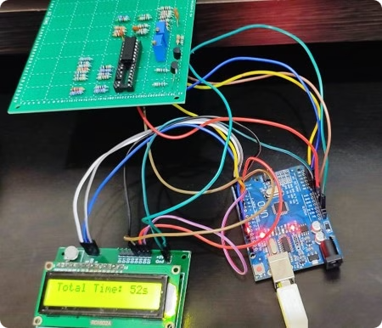
Key Benefits of Automated Water Management
Water Conservation
Prevent Overflow and Dry Running
Convenience
Reduces the need for manual monitoring, providing ease of use for operators and automated control.
Automates water supply according to actual demand, ensuring efficient usage and reducing wastage.
Safeguards pumps by preventing overflow and dry running, thus extending their lifespan and reducing maintenance.

Slide 5

System Requirements Analysis: Key Factors
1
Define Acceptable Water Levels
Establish precise water level boundaries to ensure optimal functionality and safety.
2
Temperature Settings
Determine acceptable temperature settings to prevent Damage
or malfunction.
3
Sensor Integration
Select appropriate sensors for monitoring water levels and temperature accurately, ensuring reliable data collection.
4
Microcontroller Selection
Choose a suitable microcontroller, such as Arduino or Raspberry Pi, for effective control, taking into account processing power and compatibility.

Slide 6




Circuit Design and Simulation Overview
Arduino UNO
Water Level Sensors
1
Atmega328P microcontroller for efficient control.
Transistors employed as water level sensors.
2
Control Logic
4
Analog Conversion
Designed to manage water inflow and heating.
3
LM324N comparator for signal processing.

Slide 7
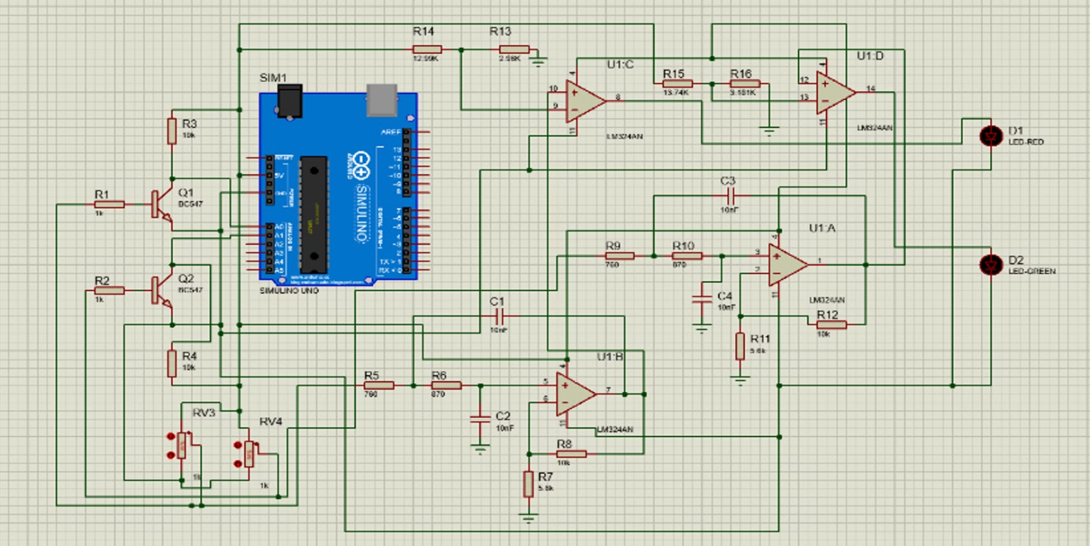
Proteus Simulation

Slide 8

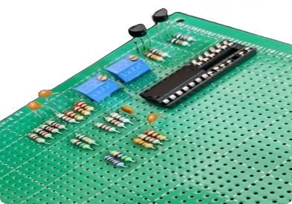



PCB Designing Process Overview
Define the Circuit
Establish clear requirements and specifications for the PCB layout, ensuring all components are accounted for.
Schematic Design
Utilize schematic capture tools for creating circuit diagrams effectively, streamlining the design process.
Component Placement
Optimize the physical layout by strategically placing components to enhance performance.
Routing
Connect components using traces to establish electrical pathways, ensuring proper connectivity and signal integrity.

Slide 9

Conclusion: Internship at SPEL Technologies
Pivotal Internship Experience
Skill Enhancement
Importance of Documentation
I enhanced my skills in microcontroller programming, sensor integration, and control systems during this period, acquiring practical experience.
The internship at SPEL Technologies significantly impacted my understanding of embedded systems, broadening my knowledge base.
The experience emphasized the importance of systematic documentation and effective project management in engineering, fostering professional habits.

Slide 10


